Slide 1
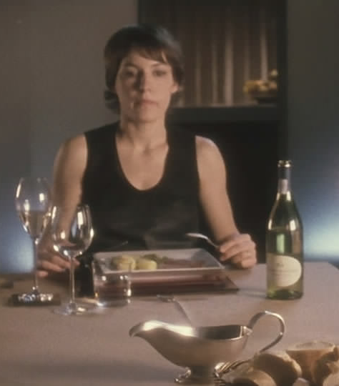
High Maintenance
(By Emma and Harry)

Slide 2
How the protagonist and other characters are established and developed
Protagonist becomes more unclear throughout film
At starts the protagonist is the woman through use of close ups and positioning with her- we are more aligned to her emotions and actions, and sympathise more for the lack of love her husband gives her
The mood shifts as she replaces her husband- makes woman appear as inhuman with bad intentions- makes us question who the real protagonist is
The film uses hi-concept ideas to really focus on a small inner-personal story about a woman on her search for fulfilment through a man.
Woman – her husband fails to meet her high standards but then fails to meet these high standards herself
Ex-husband – Boring and monotone personality who doesn’t fulfil her needs- romantically and breaks down her values by smoking. He appears bored of their relationship with lack of sexual chemistry
New husband – Appears similar to ex-husband- in physical appearance and the fact he doesn’t want to drink with her. He is more interested in the woman, up until the point where we see him switch her off and go into his normal state by smoking and watching tv.
She has the same conversation with both men inferring that she really doesn’t care about them – This is reinforced by the fact she ships the first robot off.

Slide 3
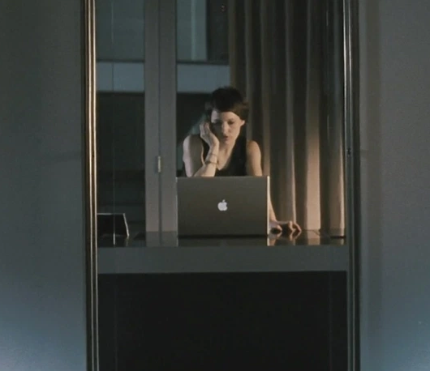
How time and place are established and represented
Futuristic sci-fi- uses high concept ideas about the future of technology and human interaction within personal relationships
Apple laptop- big corporate companies still dominate in the future- it’s no longer a way of doing everyday things but used as a market place for upgrading your husband.
Technology viewed as something to use against someone rather than communicate or help improve someone’s life
All filmed in one apartment- make the audience question the world outside
Future is clearly represented through the use of robots
The setting never changes either, so in terms of time and place it is relatively simple, but this is contradicted with the fact they are all robots.

Slide 4
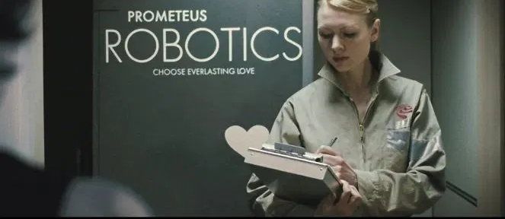
The use of enigma, narrative crisis and resolution
Open end narrative for the ex-husband- offers the question of where does he go? Another customer? Or does he get discarded and thrown away?
Enigma- is this just part of a process or a cycle? Will this happen to others?
- we aren’t introduced to the world outside of the character’s lives so can’t have a full understanding of the future world they are living in
Unexpected narrative- as woman gets her switch shut off- could be seen as ‘karma’ or a consequence for her actions as the same thing that she did to her ex-husband happens to her
We don’t know whether or not the women does this a lot – as soon as she is not interested, she switches them off.

Slide 5
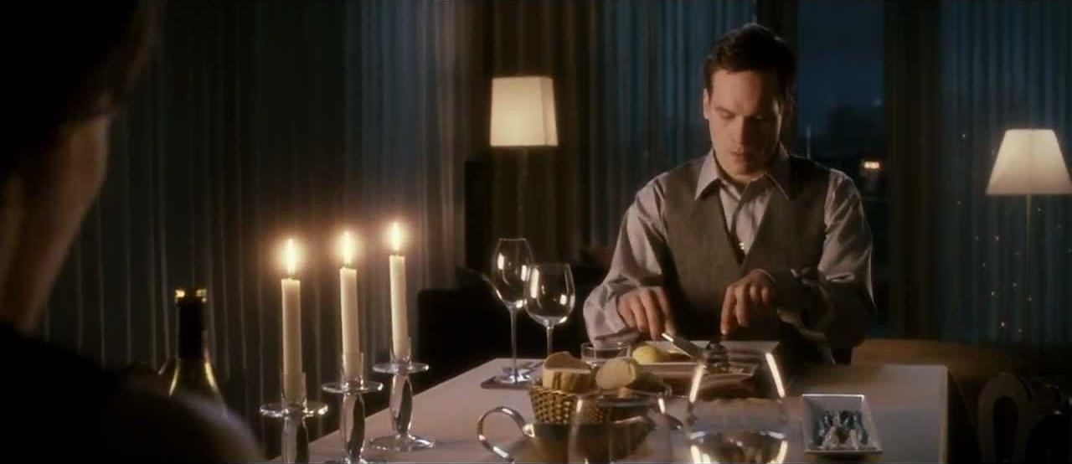
An explorations of binary oppositions in the films
Gender- man vs woman- contrast between who comes across as more powerful and are they living in an equal society between genders
The woman character vs the man character- they are not actually that much dis-similar as the same dialogue is repeated as the husband is replaced
Technology vs humanity- at first the characters appear as humans that aren’t satisfied with their normal lives (as they are bored and unhappy in their relationship) but we later find out they are androids/robots (lacking any sort of emotion or happiness)
Future vs past – We are not sure what the future is like as we only get to see a certain few people.

Slide 6
Identify and explore the messages and ideas of the film and ideology
A reflection of our current society
The film could be suggesting that soon, the world will be full of robots. It also suggest that if you are not satisfied with someone, you can just turn them off and send them away.
Prediction of what technology will turn into in the future/ the power of which technology will develop into
Gender roles between man and woman in the future- shows them as almost equal- at first we see the woman hold the power by tuning off her husband’s switch but then later gets shut down by the man who takes over that same control
Consumerism- no longer forming human relationships with people- instead turning into a materialised world where love/ pleasure is found from objects and goods. A world where husbands are modified and can be bought on the consumer market.
Comedy- repetition- by saying the lines her ex-husband said she has taken over that same boring role- endless cycle of dissatisfaction
Gender and how the roles are continuously flipped to make the man and woman seem more powerful and the dynamic between their relationship
Futuristic- criticizing technology and the future of how humans will almost turn into robots from lack of human connection
Female fulfilment through a man- Designing idealised husband – wants him to be prefect but nobody is- pointing out all its flaws when she is her own ultimate downfall- need for perfection comes at a price

Slide 7
How does the film make you feel? What does it make you think about?
Range of genres- sci-fi, horror, comedy, drama, romantic
The film makes me feel surprised by the way bot characters talk to each other. It does not represent an accurate couple on their anniversary as the main thing they talk about is Asparagus and the fact it is an aphrodisiac
Makes the audience reflect upon the importance of human connections and how we build deeper connection with people- rather than just switching them off as we get bored
Creepy and ominous atmosphere- eerie calmness and close sonic perspective makes the audience feel tense and pre-empts that a significant turning point in the film will come up soon in the narrative
Uncomfortable mood- unfamiliar way of life that the audience is not used to makes us feel strange and untrusting of the characters and their intensions
Makes the audience look more carefully into the purpose of technology and what they use it for- will it ever come to the stage in our lifetimes that we use it for our own personal and romantic gain?

Slide 8

Film Form

Slide 9
Cinematography
Aesthetic of Film Noir
Soft, light referenced the romantic genre, and the combination of the two looks blended light the way the film blends genres
High contrast look created through soft light
Functional low key lighting- lamp and candles which create an orange/ yellow tone
Mid shots of woman at table- see her full face- aligned more with her perspective
Camera- man is always obscured – gives the impression he is inhuman
Close-ups- show their lack of emotions- robot
Opening image- facing each other both at a distance in their own sperate worlds
Low key/ muted colours- unfulfilling and boring
Rarely share the screen at the same time
Woman’s perspective through over the shoulder shots and close-ups and camera is face on – camera aligns with her as the subject through positioning
Man- side on shots- seen as an object
Characters are established through close ups, and over the shoulder shots, it is made clear who the protagonist is at first because we see it from the lady’s perspective most of the time.
In the beginning, we see the lady face on, whereas, we see the men side on a lot of the time.
We rarely see both characters in the same shot and is only when they are turning of each other’s switch. This reinforces the fact that they are different and are not attracted to each other, but also demonstrates the fact that both are robotic because they do not feel the need to get close and personal with each other.

Slide 10
Sound
Diegetic Sound of wine glasses- significant as it is the cause of the argument
Dialogue- ‘Mechanical sex’- shows how they are unfulfilled as robots and have no human connection
Low drum as tensions increase- drum of a heartbeat or building up to something
Ominous non-diegetic song- associated with horror films/ dolls- robot/ not real– eerily calming/ lullaby- perhaps showing how the husband has gone to sleep
Refers to husband as ‘My current unit/ model’- rather than a human or husband
Repetition of dialogue and music- to emphasise the point of a never ending cycle
There is close sonic perspective of them both eating making it uncomfortable to watch for us but also for both characters.
There is close sonic perspective of the switches being turned off, highlighting the importance, and reinforcing the fat that they are robots and if they annoy someone, they can just be turned off which is not humane.

Slide 11
Mese en scene, editing and performance
Shift of tone- editing
Action/reaction shots-her/him- conflict in editing
Both woman and man lack emotion even when angry/ sad/ in love
Switch- significant as it represents an easy way out of life
Sign reads ‘choose everlasting love’- contradicted as this is a lie
The woman’s emotions- not genuine/ absence to feel emotions
Close sonic perspective- food- uncomfortable mood
In terms of editing, there is a lot of back and forth shots where we only get to see one character at a time, this reinforces the idea of a conversation but also highlights the fact that they are not close with each other physically or emotionally which is why they are not closer to each other on the table.
In terms of Mese en Scene, the setting is used to create a nice feeling for the characters and us as the audience, but instead is ruined by all of the dialogue as they are both arguing with each other.

