Slide 1
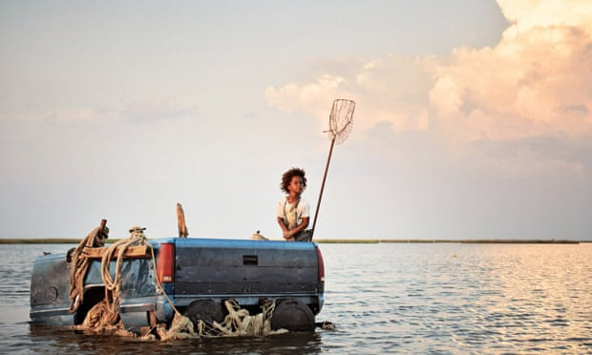
Beasts of the Southern Wild

Slide 2
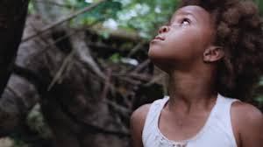
Cinematography
The audience is placed within the action creating immersion and, frequently, conveying realism.
The film was predominantly shot on an Easyrig which lends documentary style to a lot of the footage
Prevalence of shots from Hushpuppy’s perspective or at least from her the perspective of someone her height keeps her at the centre of the narrative and encourages spectators to align themselves with her
The firework scene where the camera operator joins the party and takes the audience running through the location with the characters.
Uses a handheld camera and heightened camera movement– often avoids compositional elements like focus and framing to give a documentary effect
16mm film stock- grainy, soft focus, documentary style
Camera tracks Hushpuppy
Hushpuppy low angle eyeline shots- using over the shoulder shots.

Slide 3
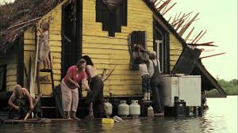
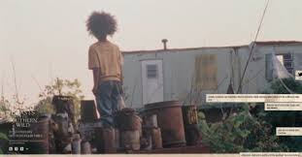
Mise en Scene
The homes were constructed by local artists and boat builders to create very idiosyncratic, unique sets that reflected the characters and unusual lifestyles of the inhabitants of the bathtub.
The filming location of Isle de Jean Charles in South Louisiana is severely affected by land loss so it conveys the sense of peril and emergency very authentically and the people who live there and became involved in making the film have useful experiences to draw on.
Wink’s boat is welded out of flatbed and an old pick up truck- establishes his dismissal of modern society and conventional culture
Levee- acts as a symbolic and physical barrier that separates the Bathtub from traditional modern society – divide between class, wealth, morals and values.
Hushpuppy lives in a home separate to her father Wink- Hushpuppy is independent but may be considered to feel lonely
Animals- Hushpuppy can relate more to the animals/ hear their heartbeats/ connect to those in nature/ sympathise with them.

Slide 4
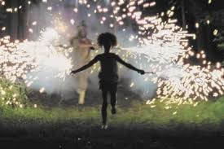
Editing
Hushpuppy was prioritised by ensuring that the majority of shots included her or were from her point of view.
Wink’s demise was predictable from early in the film so the film’s predominantly linear narrative was emotive as we watched his inevitable decline with Hushpuppy.
Use of Wink’s flashback of meeting Hushpuppy’s mother was lent greater power by being the
only such scene in an otherwise linear film.
Opening sequence uses montage editing to emulate the excited and energetic festival atmosphere
Linear narrative
Increased cutting rate during festival celebrations- disorientating and lively mood
Flashback sequence in a linear film- shows significance of the scene and how its importance contributes to the narrative and Hushpuppy’s development- lends a greater power to show how Hushpuppy has grown and provides context to her independent and individual nature.

Slide 5
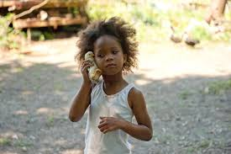
Sound
Second-line parade culture, jazz-funeral culture is a huge part of the celebration sequence at the start of the film that defines the town. A funeral in New Orleans begins with these tragic dirges but then transforms into a celebratory, joyous party. This sequence, and this music, is crucial in conveying the positive aspects in living in a vulnerable place at a challenging time.
Use of Hushpuppy’s voiceover from the film’s opening moments and throughout conveys her isolation as well as giving the spectator insight into how she perceives the world.
3 reoccurring songs- Cajun and folk music score co-written by Zeitlin and Dan Romer reflects the chaotic whirlwind of life in the Bathtub.
Voice over- subjective positioning- we view the world through Hushpuppy’s outlook/ perspective
Close sonic perspective of heartbeat- shows that Hushpuppy has a connection with nature and the world around her. Represents her humanity
Lullaby twinkly music- child like innocence
Parade folk music- parade culture/ upbeat/ sense of community

Slide 6
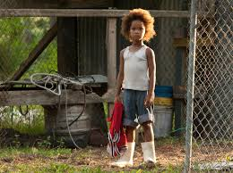
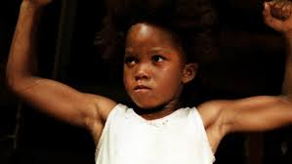
Representation
The Levee as a physical barrier between different social groups can be read as a visual representation of social/racial division.
Attitudes to gender and strength. Wink tries to encourage Hushpuppy to feel strong by referring to her as a man, “you gonna be the last man in the bathtub” and criticising emotions and weakness, “that’s just a side effect of being a stupid little girl.”
Hushpuppy is represented as animalistic from the opening scene to the scene where she is encouraged to ‘beast it’. This could be read as problematic racial stereotyping.
Wink and Hushpuppy’s family relationship is unorthodox
Wink’s parenting style is rough, neglectful yet caring and loving- he teachers her harsh lessons about growing up, independence and being a ‘man’
Dehumanising the bathtub dwellers as people living in poverty who have to scavenge for their food in an animalistic way
Glamourises poverty/ lower class and doesn't fairly represent the harsh reality of living in poverty and the consequences that come along with it.

Slide 7
Contexts and Ideology
Inspired by Hurricane Katrina and its aftermath in 2005. Zeitlin said, ‘I live in New Orleans and was interested in telling a story about people who are staying in South Louisiana and why they’re holding on. I wanted to celebrate that impulse to stand by this place, in spite of its dangers or flaws.’
BOTSW is a film about communities on the edge of the world.
The film cheers the Hushpuppy as the underdog throughout as the audience are encouraged to share the joy of these characters surviving in the most challenging of situations. A clear example is the portrayal of the authorities trying to evict the vulnerable and unwell Wink and the young Hushpuppy very forcefully.
Nature vs Civilisation – contemporary America, the dry world’, is criticised as inauthentic and ugly throughout the film. Hushpuppy states, “They got fish stuck in plastic wrappers, they got their babies stuck in carriages, and chickens on sticks and all that kind of stuff.’
Climate change
American attitudes to US politics
Hurricane Katrina
Contemporary America
Class and wealth divide
Poverty
Industrialization/ urban
Nature
Independence
Age
Gender and strength
Inequality
Future generations

Slide 8
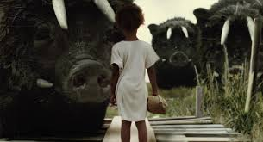
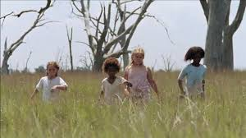
Spectatorship
Prevalence of shots from Hushpuppy’s perspective plus her voiceover and the fact that she is in every scene encourages the spectator to align themselves with her.
Contemporary events may impact upon a spectator’s reading of the film i.e. recent demonization of the outsider and suggestions that walls be built to keep ‘them’ out. As Hushpuppy says, ‘They built the wall that cuts us off.’
The sense of realism created by handheld camera, use of non-actors, authentic locations and sets may intensify the emotional response for the spectator. Conversely, the use of magic realism e.g. the aurochs may shatter this illusion of reality and therefore lessen the spectator’s sense of immersion.
We are positioned with Hushpuppy’s through the use of over the shoulder and POV shots and are aligned with her throughout the film

