Slide 1

La La Land

Slide 2
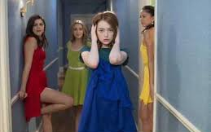
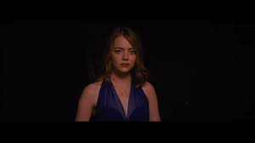
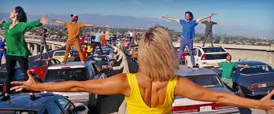
Cinematography: Single Shot
All the main song and dance scenes are filmed in what appear to be a single take, in homage to the Hollywood musicals of the 30s, 40s and 50s. Shooting in a single take allows the audience to fully appreciate the choreography and skills of dancers like Gene Kelly in Singin’ in the Rain (1952) or Fred Astaire and Ginger Rogers.
The camera constantly moving means the audience is put in the motion of the dance number, recreating the thrill of watching performances live in a theatre.
Constant movement punctuates the fluid shot in the way a cut usually would- this could be using a sharp whip-pan.
Camera immersed in crowd- make audience feel part of celebration and upbeat atmosphere and share the enthusiasm with the actors/dancers.
Tracks into Seb playing the piano- draws significance
The camera tracks behind Mia to position us with her anticipation, but halts abruptly when Seb barges rudely past her. This indicates that this film isn’t quite the romantic dream we might expect.

Slide 3
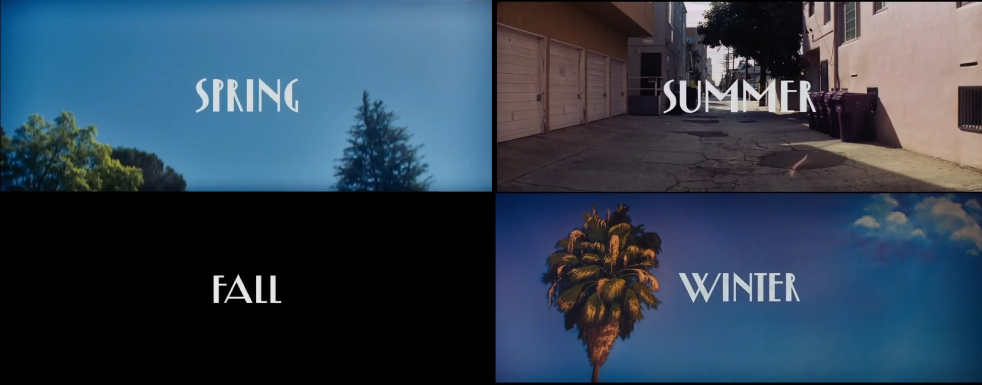
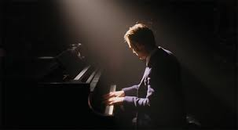
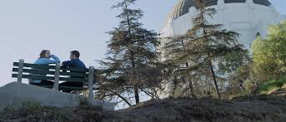
Mise en Scene
A spotlight is used throughout to pick out the character and to reflect their aspirations: to be on stage/screen, a star. As Seb plays the lighting of the restaurant dims into darkness as he begins playing his own composition. The light fades away into a single spotlight as he stands and we expect applause, but instead the spot vanishes the normal lighting of the restaurant returns bringing him back to the harsh reality.
La La Land prominently uses primary colors, red yellow and blue, to symbolize how Mia and Seb are separated/ in conflict, however when they come together and are at their closest we are presented with a purple color- a mix of those primary colors.
Season title cards inspired by Vincente Minnelli’s ‘Meet Me in Saint Louis’, representing a bold technicolor world.
The film uses a mixture of typically LA locations from the gritty (vast congested freeways) to the romantic (Griffiths Observatory), often repainting or lighting the less pretty locations in a way that creates a dream-like Technicolor atmosphere- inspired by Minelli’s bold technicolour experience. This signals the shift between the fantasy musical genre and the romantic drama genre, showing a colourful idealised representation of LA contrasted with a realistic version in which we see the world Mia a struggling actress lives in.

Slide 4
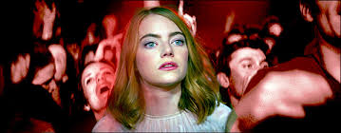
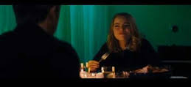
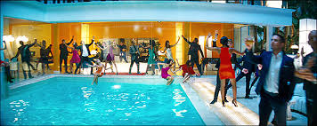
Editing
In ‘The Messengers Gig’ and the ‘Dinner sequence’ the cutting rate increases reflecting the character's growing frustration tension building, creating a claustrophobic mood and showing Mia and Seb growing apart. In the gig scene the use constantly changing camera angles and camera shots mimic the excitement and energy of the crowd, while also showing Mia’s shock and confusion. In the Dinner sequence the fast cutting rate includes lingering shots on Mia and Seb’s faces showing how the convocation has been lost as the character's are in conflict and opposed to one another.
In Seb’s apartment there are sharp jump cuts of coffee, a turntable etc. This jerkiness also echoes the way Seb replays the same section on the record. Once he begins to play both here and in the club, the camera becomes a gliding presence, witnessing his performance, similar to in the dance scenes.
The extended single takes used during the song and dance routines are floating and dreamlike, and they wanted to make the dramatic sections more ‘realistic’ to distinguish them and root the film in some of the frustrations of the main characters. For this reason, there is a fast cutting rate in these scenes that creates a sense of near claustrophobia, so that the musical numbers are like ‘an exhaled breath’ where tension is released.

Slide 5
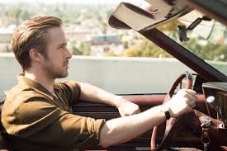
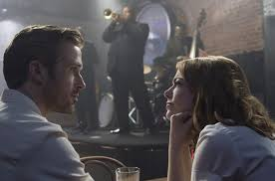
Sound
As the camera tracks along the cars, there is a diegetic use of music as we hear what each driver is listening to. This grounds the film in reality, before the camera rests on the first singer and the music changes to non-diegetic for the first dance number.
The lyrics to the song establish one of the main themes of the films- the sacrifices when they move to Los Angeles to pursue their dreams of fame. The song ‘another day of sun’ celebrates the heat and ambition of LA in an optimistic way. It represents the LA attitude of getting back up and trying again- establishing the ground for Mia and Seb’s relationship.
The music Seb is instructed to play and the contrast with his own jazz compositions encapsulate one of the film’s main themes: the conflict between what is commercial, banal
and ‘popular’ and authentic artistic integrity, staying true to one’s craft. The dialogue here also shows Seb’s stubbornness and his struggle with compromise: ‘Mutual decision, then,’ he says when his boss tells him to stick to the playlist. ‘Yes, made by me’, the owner retorts. ‘Signed off by me’, Seb insists on adding.

Slide 6
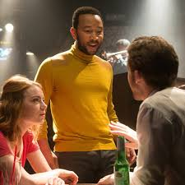
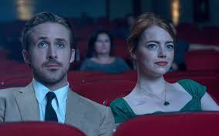
Representations
La Land represents artists as individuals who struggle to reconcile their creativity with everyday life. In both films, the main characters have to sacrifice their relationships in an attempt to achieve their dreams
Seb represents obsession with nostalgia and clinging onto the past whereas Mia represents change and the LA work ethic.
The representation of gender in the film was criticised as Mia appears to be quite a passive character. Many of the key plot events are precipitated by Seb- he pursues her to her coffee shop and converting her to liking jazz. Mia is seen as Seb’s spectator as she watches Seb performs, whereas he fails to even show up for her play. However, it is Mia who achieves the most success by the end.
The lack of racial diversity was also criticised. Considering the size of the African-American and Latino communities in Los Angeles there are few people of colour after the opening scene. Additionally, for a film about jazz music, the only single black speaking role is Keith – who is portrayed as sell-out to commercialism compared to Seb’s obsession with jazz ‘purity’. This neglects to mention LA’s turbulent history- 1992 Rodney King riots

Slide 7
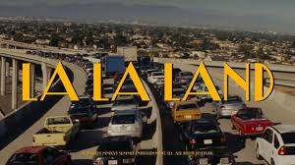
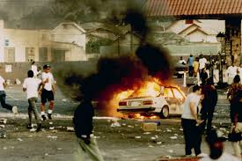
Historical and Political Contexts
La La Land is said to gloss over LA’s turbulent history, especially issues concerning race.
In 1990, there were riots in the wake of the acquittal of LAPD officers accused of beating black motorist Rodney King, and in the 1940s there were the ‘Zoot Suit Riots’ where black jazz fans were viciously attacked by large gangs of white people. These racial conflicts are ignored by the film and the black community.
It could be argued that La La Land is deliberately Apolitical in order to provide a sense of escapism from the world around us and forget the current political struggles to enter a world of positivity and bold colour.
The film ignores political and religious ideologies linking to LA’s history ignoring real world issues and making the world inaccurate and dream-like.

Slide 8
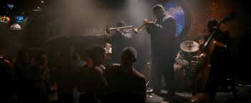
Ideologies
The world Seb wants to return to is a world before jazz became political, a time when LA was riven by racism and during the 1940s
Lack of political engagement and obsession with nostalgia that makes it worthy of political dissection.
Representations of gender and race, as well as a complete absence of any LGBTQ characters
Both characters do achieve their dreams at the end- whilst this means living in a frozen past for Seb, for Mia it means embracing the new
Nostalgic entertainment- a return to the past is only beneficial for white middle class people: ‘The past represents liberation for one group, a horror show for another’.
1930s may be from a world of more traditional glamour and romance, but they also hide and distract from the racial discrimination, gender inequality and homophobia of this period of time.
Escapism
Nostalgia
Dreams and achieving your goals
Optimism
Career and work ethic- sacrifice
Personal values
Gender
LA community

Slide 9
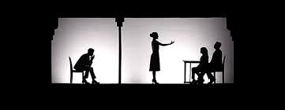
Spectatorship
Gender politics- accusing it of being a male fantasy about artistic integrity that Mia just facilitates and applauds as there are a lot of scenes of her watching Seb perform.
Celebrates Mia and the audience experience- shows being a spectator as positive and something to take experience from- she revels in the experience of consuming art: jazz, cinema, cheesy 80s pop, theatre.
Mia then takes these as inspiration to create something new: the film that makes her a star has no script, a little like her life.
The final ‘dream ballet’ medley is her fantasy of how she could have her success and Seb, but in this version we follow along Mia’s story and see how Seb becomes her Spectator
In the process she moves the joy of spectatorship to power into becoming a star.
Mia ultimately leads the narrative.
We get the impression that Mia is always working when she is not shown on screen- working in the coffee shop, writing her play and constantly going to auditions showing her work ethic may be greater than Seb’s.

