Slide 1
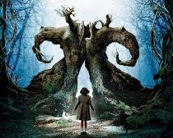
Pan’s Labyrinth

Slide 2
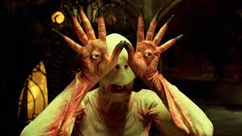
KEY THEMES
Fascism (and it’s effect on Spanish identity)
Good versus Evil
Childhood & National Innocence (and the loss of it)
Reality and Fantasy
Legacy – continuing the bloodline
Death / Rebirth
Organisations versus Free Thought
Conformity (passive engagement) versus Rebellion (active engagement)
Creation versus Destruction
Restoration of the Family unit
Women in crisis
Rejection of structured Religions
Oppression (physical, psychological and emotional) and Control versus Freedom
Faith in the old world seems to transcend the religions of man and those in league with fascism- reoccurring theme

Slide 3
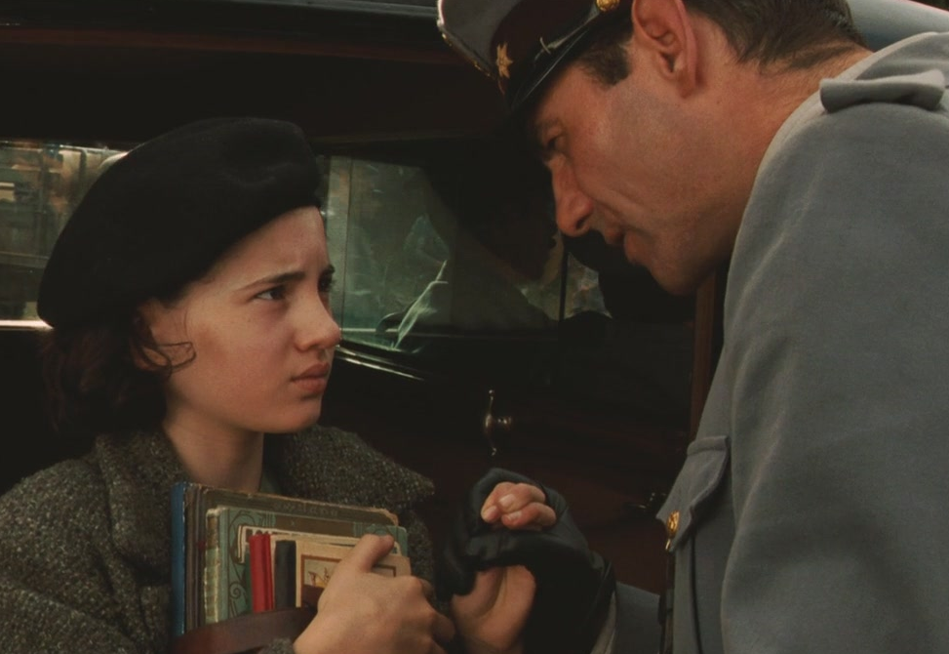
REPRESENTATION: Gender
Women:
Responsible for creating / saving life (Carmen gives birth, Mercedes helps the rebels, Ofelia’s re-birth)
Carmen ]and Mercedes reflect 2 sides of Ofelia – the need to conform to fit into new family’s life and rebel against fascism.
The binary opposite of the males within the film:
Carmen- negative representation of women.
Ofelia and Mercedes- positive representation of women.
Men:
Responsible for the civil unrest of the real-world backdrop of the film’s narrative.
Vidal represents right wing authoritarian Fascism
Pedro represents the left-wing liberal rebellion.
Clash between all men which leads to war.
Destructive, legacy / war obsessed- Captain Vidal is obsessed by his fathers’ military exploits and is equally determined to have a son.
The health of his sick wife is of only secondary importance-Vidal he scolds her for discussing their romance in public and is equally dismissive of his stepdaughter, Ofelia.
The binary opposite of the females within the film:
- Vidal- negative representation of men. ( Vidal is killed by a man (Pedro) not a woman (like Mercedes), despite their perceived strength of character)

Slide 4
REPRESENTATION: Family, Age, Fantasy
Family:
The family is restorative and ultimately restored in the film but only in the fantasy narrative.
Her completed family is Ofelia’s quest reward.
In the real world her family is broken and destroyed
Strong bond between brother / sister- Ofelia & her baby brother and Mercedes & Pedro.
Age
The innocence of youth is displayed through Ofelia – her timid nature gives way to strength of her character.
Her youth reflects the way she creates the fantasy world – full of hope and wonder.
Contrasted with the morally complicated lives of human and the decrepit performances reflected in the Faun and Pale Man.
Reality / Fantasy:
The fantasy narrative is often lit in bright warming colours which reflect the magical nature of the narrative.
Contrast this with the often dark, dismal colour palette of the real
Sometimes the lighting is similar like pale man’s banquet and Vidal’s dinner party- narrative suggests the fantasy / reality are same.

Slide 5
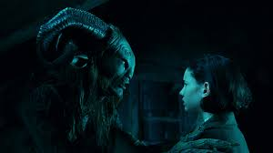
REPRESENTATION: Politics and Nationality
The narrative of the film attempts to establish and discuss the complicated nature of Spanish identity and how history has influenced this international perception.
Focuses on the oppressed and what is being resisted rather than just a political anti-fascist allegory.
Political criticisms within this analysis of national identity.
A religious Crusade allegory- ignorance of those institutions who profited and turned a ‘blind eye’ towards the inequalities associated to a Spanish fascist regime from the ultra right-wing mode of politics.
The bourgeoisie’s exploitation of the proletariat was overlooked in favour of personal profit.
Collective national shame and consequences of this political approach.

Slide 6
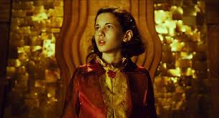
AUTEUR
An obsession with fantastical horror
He considers himself an outsider in terms of his own artistic integrity
Mexican / Spanish filmmaker in an American context.
Allusions to Victor Frankenstein
A fascination with the ambiguity / role reversal of heroism and villainy
Some monsters are misunderstood and alienated, while some humans have a morality that is hideous.
Common narrative tropes - such as the figure of the child as a cipher witness and portrays a certain child-like innocence and perspective
Reoccurring themes of Horror, Sci- fi, Fairy tale, Political, War, fantasy.
Likes to undermine / question the nature of rule and order - Fascist rule, logic, simplistic binaries of good and evil that acts as a catalyst of dark chaos, disorder and madness.
Creates fairy-tales for adult audiences - Monster movie as serious art-form / Bleak or ambivalent denouements / Children as victims of violence / graphically portrayed / danger is real not imaginary / refusal to allow safe passage for child characters.
He uses the fantastical to say something profound about history, like the Spanish civil war.
Influences- slasher films, comic books, horror, Goya paintings, surrealist and social realism photography, Gothic allegories, Spanish and Mexican historical context

Slide 7
AESTHETICS
Concentration of magical fantasy world that Ofelia creates however, the aesthetic is very much real and humanised.
The fairies, in particular, obtain humanistic characteristics
Realistic aesthetics- practical effects over CGI so the physicality makes it much more real
Emphasis on the grotesque nature of the creature designs practical effects and settings.
Using small canvases to tell big stories- The props and scenery are authentic to the 1944 time period that it takes place in.
Intricately constructed scenery such as the Captain’s room featuring clocks and machinery in the background to reflect his rigidly structured life.
Repeated motif of facial trauma to emphasise the brutality to the audience as well as provoking empathy.
Paganism motif- religion, gothic and gore- The moss-covered labyrinth ruins / associated standing stones, & the tree beneath which Ofelia finds the toad & from which blooms her own resurrection all suggest a sophisticated and elemental pagan past now acting as portals to the fairy kingdom.
Colour palettes and lighting to establish distinctly different worlds- The captain’s world (blue and grey), the nature world (greens and browns) and the fantasy world (yellows, oranges and gold colours)
References to the paintings of Francisco Goya in particular his painting Saturn devouring his Son within the Pale Man sequence, reflecting madness and sorrow.
A sense of a moral grey area and the development of ‘cruel worlds’- juxtapose violence in both worlds, in both contexts. So the fantasy has a lot of violence as well
Cinematography reflects a restless fluidity
Symbolism employed to imply metaphor and subtext - Fig tree as imagery for fallopian tube / traumatic birth of Fascist ‘clean new Spain’ – painful iconography / Hunting rabbits as an allegory of violent class conflict / Time as metaphor for mortality.

Slide 8
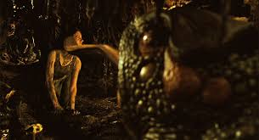
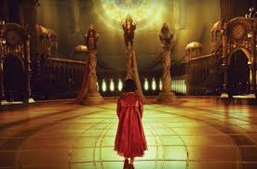
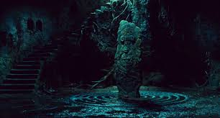
FAIRY TALES
The Princess and the Frog / The Frog Princess:
The most common similarity is the presence of the anthropomorphic frog (although the amphibian within Pan’s Labyrinth is more malevolent). Another similarity would be the royal ancestry of the main protagonist.
Alice in Wonderland:
The main similarity is the dress worn by Ofelia within Pan’s Labyrinth - but Ofelia also finds herself in a strange world of fantastical creatures. Oppositely though Alice wants to return to normality whereas Ofelia wishes to emigrate to fantasy.
Snow White
The predominant relationship between Snow White and Ofelia is in with both characters’ connection to nature. Ofelia has a strong connection to the faun and the fairies which inhabit the ancient forest / labyrinth which play a central role to the plot.

Slide 9
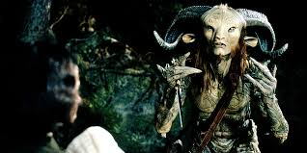
INFLUENCES
Gothic Writers- Bram Stoker, HP Lovecraft, Mary Shelley
Painters- Francisco Goya – Saturn Devouring His Son, Hieronymus Bosch - Symbolist
Surrealist Photographers- Man Ray, Joel Peter Witkin
Social Realism Photographers - Robert Capa, Henri Cartier-Bresson
Victorian fairy tales- Rapunzel, Cinderella, Snow Queen, King of the Golden River, Story of the Three Bears
The Spirit of the Beehive- Central girl protagonist who develops an imaginative space in response to dramatic political contexts and personal trauma
Children’s Illustrators- Arthur Rackham, Frank Franzetta
Comic book artists and video game developers- Mike Mignola, Dark Horse Comics
The Diary of Anne Frank - Ofelia as literary war figure, child escaping through story, tragic end for the Protagonist.
References to mythology- Faun’s, fairies, magic toads
Alice in Wonderland – Ofelia as an Alice-type figure going down the fantastical rabbit hole into a realm of adventure
Spanish Army symbolism - CNT anarchist propaganda, 1937 Civil War context.
1970s Slasher B-Movies- Halloween, Texas Chainsaw Massacre, A Bay of Blood

Slide 10
CONTEXTS: Social, Historical and Political
SOCIAL:
The representation of women is evidence of the social problems women faced in this patriarchal and macho era - women are oppressed in a show of hyper / toxic masculinity.
Catholic church- the corruption of the local middle classes and ruling elite/ the complicity of the Catholic church
Spirituality of his native religion- stylised heaven with its church-like setting, a rosary window flooded with golden light and a grey bearded father figure flanked by a doe-eyed mother
Celebration of childhood
HISTROICAL:
1944 in Spain- a period where the rumblings from the Spanish Civil War are still being felt despite the war itself having finished in 1939. Franco’s support of Hitler belies Spain’s direct involvement in World War 2. Fascism continued to be the predominant political system until Franco’s death in 1975
POLITICAL:
Poverty of fascism in general – in contrast to the more benign and sensitive (although hardly democratic) fairy kingdom.
Political representation of the guerrillas / rebels who are presented as resourceful, determined and egalitarian. They are also inextricably linked to the natural environment of Spain’s heartland.

