Slide 1
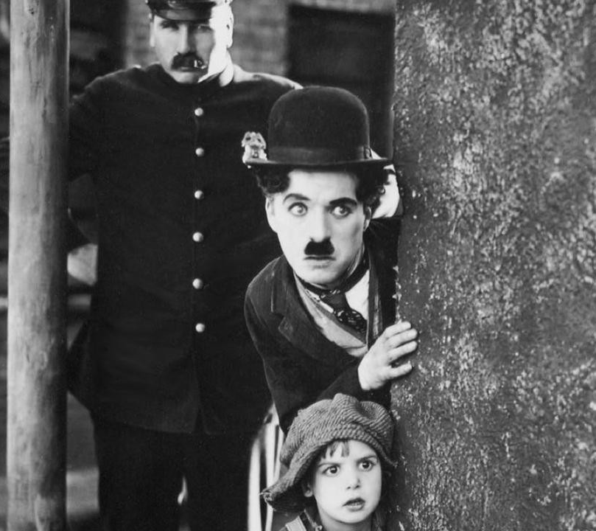
Classical Hollywood cinema

Slide 2
When did it start?
Classical Hollywood era is a term used to describe both a narrative and visual style of film making, which became characteristic of American cinema between the 1910s and the 1960s. Starting rapidly after the first world war.

Slide 3
Where did it start?
The climate and location of Hollywood was ideal place for outdoor filming and, by the 1920s, 85% of American movie production was made in or around Hollywood.
The Golden age of Hollywood began when the first major feature-length silent movie was made in 1915.

Slide 4
How did it start?
In the early 1900s, most motion picture patents were held by Thomas Edison's Motion Picture Patents Company in New Jersey, and filmmakers were often sued to stop their productions. To escape this, filmmakers began moving out west to Los Angeles, where attempts to enforce Edison's patents were easier to evade.
During the era of classical Hollywood, the start of the Golden Age occurred. This was arguably started with the film called 'The Jazz Singer' which was released in 1927, it increased box-office profits for films as sound was introduced to feature films.

Slide 5
Key films from this era
The Jazz Singer. Alan Crosland, 1927.
City Lights. Charlie Chaplin, 1931.
Scarface. Richard Rosson, Howard Hawks, 1932.
King Kong. Merian C. Cooper, Ernest B. Schoedsack, 1933.
Duck Soup. Leo McCarey, 1933.
Dinner at Eight. George Cukor, 1933.
It Happened One Night. Frank Capra, 1934.
Mutiny on the Bounty. Frank Lloyd, 1935.
Casablanca. Michael Curtiz, 1942

Slide 6
Video clips from key films from the era
https://www.youtube.com/watch?v=g9OmTSM0i9s - Scarface (1932) Café Hit scene.
https://www.youtube.com/watch?v=ZJKfmsuvGHg - City Lights (1931) Ending scene
https://www.youtube.com/watch?v=EQNQqwFK-OM - Dinner at Eight (1933) Ending scene
https://www.youtube.com/watch?v=rnaCi4rBfqw - King Kong (1933) The Bridge of Kong scene

Slide 7
Key film directors from the era
Alfred Hitchcock – Made films such as ''The Farmers Wife''
Anthony Mann – Made films such as ''Men in War''
Billy Wilder – Made comedic films such as ''Ball of Fire''
Blake Edwards – Made films such as ''Panhandle''
Charlie Chaplin – Made films such as ''The Greatest Dictator''
Cecil B. DeMille – Made films such as Sampson and Delilah
David Lean – Made films such as ''Brief Encounter''
Douglas Sirk – Made films such as ''Imitation of Life''

Slide 8
Who were the biggest ‘stars’ of the era?
Humphrey Bogart – Casablanca
Cary Grant – Charade
James Stewart – Anatomy of a Murder
Marlon Brando – Apocalypse Now
Fred Astaire – Funny Face (sound-track)
James Dean – East of Eden
Gary Cooper – High Noon
Spencer Tracy – Guess Who's Coming to Dinner

Slide 9
Which genres were the most popular?
The Screwball Comedy
Film Noir
The Horror film
The War Film
The Social issue Film
The Musical
The Gangster Film

Slide 10
What film styles/techniques did this era create?
This era introduced a lot of technical innovations such as: close up, pan, long shot and 3 point lighting.
As well as this there were innovations In terms of acting. Because people couldn’t say how they feel, actors had to exaggerate each action to convey how they felt.

Slide 11
Which major studios were active?
Warner brothers, Metro Goldwyn Mayer and Paramount were considered as the major studios in the 1920s, with it being said then that they held too much of the industry as they had started distributing the films as well as producing them.
Charlie Chaplin himself started a film studio called the United Artists in 1925, with his first film for it being 'The Gold Rush'

Slide 12
What are the biggest box office successes of the era?
The General (1926) - American comedy about a man chasing down his locomotive which was stolen by union spies.
The Gold Rush (1925) - American about Chaplin's search for gold and his finding of more.
City Lights (1931) - American romantic comedy about Chaplin's tramp falling in love with a blind woman.
Greed (1924) - American thriller about a lottery win spawning destructive greed

Slide 13
Why did the silent part of this era end? What was the first ‘talkie’ in this movement?
The first ever talkie was a film from 1927 called ' The Jazz singer'. And after this film came put, by the 30s most films became talkies.
This change happened due to an improvement in the technology at the time as audi0 synchronization had become a lot better and more applicable to each film

