Slide 1
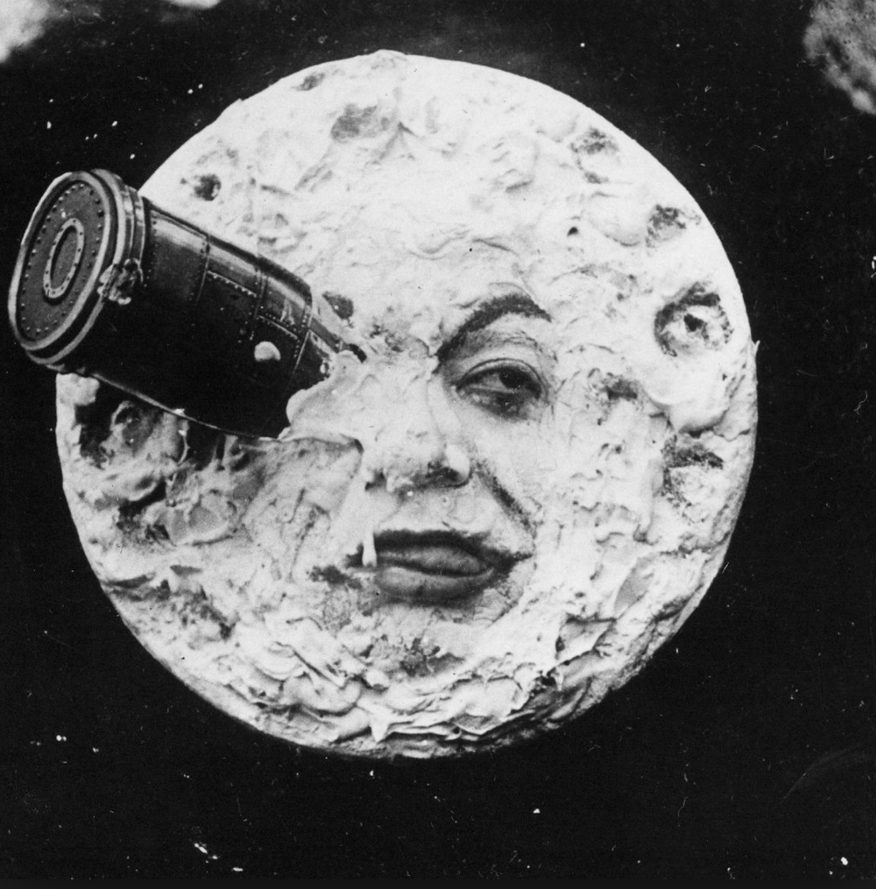
French Impressionism cinema

Slide 2
When did it start?
French Impressionism Cinema began after the war ,in 1918, with the first film from this movement being 'The 10th symphony' (1918)

Slide 3
Where did it start?
French Impressionism Cinema began in post-WWI France, rooted in French nationalism.
French production companies were eager to create films that were not American, so they were supportive of the native French filmmakers.

Slide 4
How did it start?
It was Inspired by the increasing dominance of American Cinema after WW1
Before cinema, the french were inspired by live theatre and instead of continuing this, saw film as a way to articulate emotions, situations and subjective realities

Slide 5
Key films from this era
Some key films that defined this era are:
J'ACCUSE (1919) by Abel Gance
MAN OF THE SEA (1920) by Marcel L'Herbier
EL DORADO ( 1921) by Marcel L'Herbier
THE WOMAN FROM NOWHERE (1922) by Louis Delluc
A SORRIDENTE MADAM BEUDET (1923) by Germaine Dulac
NAPOLEON (1927) by Abel Gance

Slide 6
Video clips from key films from the era
https://www.youtube.com/watch?v=pO_M8zfIe6I - 'March of the Dead' scene from J'accuse (1919) - a WWI film.
https://www.youtube.com/watch?v=Pc5KFJo5n8M - Key scenes from L'Homme du large (Man of the Sea) (1920) - a film based on a short story.
https://www.youtube.com/watch?v=DXdG2YChZZY - A clip from El Dorado (1921) - a film notable for a number of technical innovations.
https://www.youtube.com/watch?v=VgyLwF_i5oY - A clip from Napoléon (1927) - a film about the early life of the French ruler.

Slide 7
Key film directors from the era
Abel Gance
Louis Delluc
Germaine Dulac
Marcel L'Herbier
Jean Epstein

Slide 8
Who were the biggest ‘stars’ of the era?
Edmond Van Daele
Claude Benedict
Suzy Pierson
Jeanne Helbling
Jean Debucourt

Slide 9
Which genres were the most popular?
French Impressionism films were often war films, due to the movement being post WWI with a big emphasis on French nationalism - Rose-France (1919) was known for its patriotism.
As well as war, French Impressionism films were also heavily rooted in the drama genre – these films put an emphasis on emotional representations, rather than portraying reality, so films were often dramatized.

Slide 10
What film styles/techniques did this era create?
The french were ambitious and wanted to create beautiful and aesthetic films with psychological meanings
Some techniques that had lots of influence that were created in this era consist of non-linear editing, innovative lighting, attempts to portray dream sequences and fantasies, and other methods to tell a story from a protagonist's point of view.

Slide 11
What are the biggest box office successes of the era?
French Impressionism had varied success at the box office.
Napoleon 1927

Slide 12
Why did the silent part of this era end? What was the first ‘talkie’ in this movement?
L'herbier made the first fully talking French film called L'Enfant de l'amour (1929)
The gradual transition from silent films to talkies took place between 1926 and 1930 and eventually sound films took over with the technological outburst allowing sound to be used in films

