Slide 1
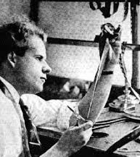

Sergei Eisenstein
Soviet film Maker

Slide 2
Early Life
Sergei Eisenstein was a soviet film maker and theorist
He was born in Latvia 1898 and died in Russia 1948
Former engineering student
Eisenstein was known for using the ‘Soviet montage’ – in his concept of film, montage, perhaps independent of the “main” action, are presented for maximum psychological impact.
After studying in 1916–18 at the Institute of Civil Engineering, Eisenstein decided on a career in the plastic arts and entered the School of Fine Arts.
During the 1917 Russian revolution, he enlisted in the Red Army and helped to organize and construct defences and to produce entertainment for the troops.
In 1920 he moved to Moscow to pursue theatre as an assistant decorator
He started writing screenplays and in 1923 became a film theorist
In 1925 he produced his first film Strike

Slide 3
Filmography and aesthetics
He is well known for his silent films Strike (his first film), Battleship Potemkin and October, as well as the historical epics Alexander Nevsky and Ivan the Terrible.
In 1928 he was criticized by the soviets after his film ‘October’ and began traveling over Europe to learn about sound motion picture
In 1930 he was invited to America by Paramount pictures produce a film
Eisenstein provided a blue-print to how film makers incorporate soviet montage theories in particular to fiction films
He proposed a new form: the “montage of attractions” in which chosen images, independent of the action, would be presented not in chronological sequence but in whatever way would create the maximum psychological impact.
He believed that the filmmaker should aim to establish in the consciousness of the spectators, the elements that would lead them to the idea he wants to communicate
The effect of these ideas can be seen in the rapid cutting of modern action sequences, or the rhythmic edits of music videos
The power of the edit allowed shots to be cut together to create brand new meaning that was not present in the original shots.
Eisenstein avoids focusing on a single, central protagonist in favour of focusing on the meaning

Slide 4
Soviet Montage theory: The five theories
Intellectual montages- the juxtaposition of two unrelated images to create a third idea in your mind
Metric montage- shots are cut after a specific number of frames regardless of what’s happening in the shot- the speeding up or slowing down of edits can affect the tension in the audience
Rhythmic montage- matches the cuts to music, sound effects or actions on screen
Tonal montage- The Tonal Montage is the use of two or more shots that support one another and build a theme, quite to the opposite effect of the Intellectual Montage
Overtonal- combination of the four other types of montages: Intellectual, Metric, Rhythmic and Tonal.

Slide 5
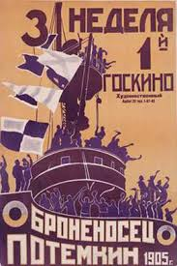
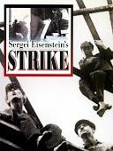
Themes
Abuse of Power
Death and suffering (Martyrdom)
Repetition of History
Collective Action
Class and oppression
Lack of Mercy
Brotherhood

Slide 6
Influences
Eisenstein was influenced by:
Ivan Pavlov for his work in phycology
Vladimir Mayakovsky- a Russian-Soviet poet
Karl Marx- a German philosopher well known for the Marx theory on communism and class
Sigmund Freud- an Austrian neurologist
Richard Wagner- German composer
In Film he refers to Alfred Binet's experiments on the brain and finds insights in anthropology and linguistics (113).
He was influenced by Asian culture- he viewed the Japanese writing system, which consisted of "ideograms" to be relevant to montage in cinema.
He took inspiration from all forms of art- One of his most important influences was modernist novelist James Joyce, who wrote Ulysses and Finnegan's Wake looking at the idea of the ‘inner monologue’ and he used it within Marxist cinema
Eisenstein also took inspiration from visual art- the Constructivist movement took place in Russia in the 1920s in which they believed that art should serve a clear social purpose

